Slide 1
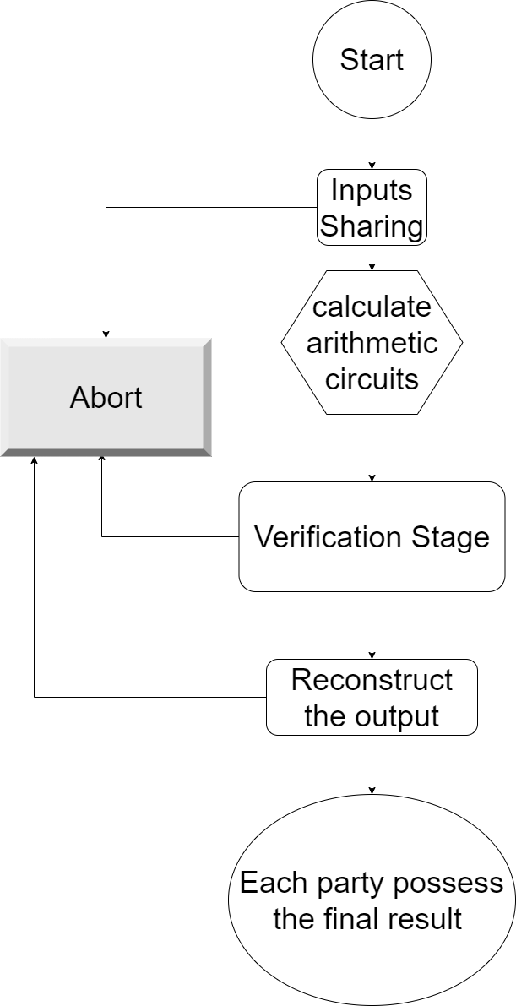






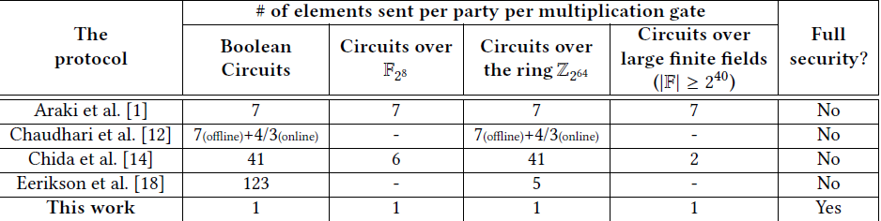




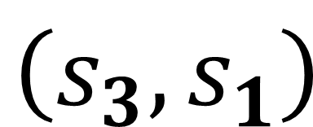


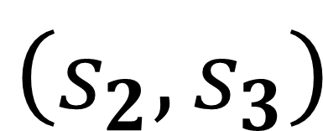
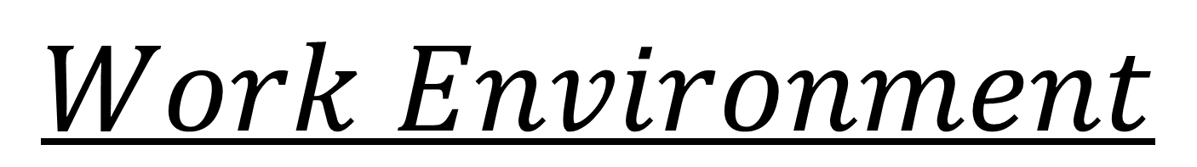
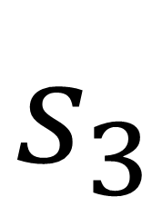
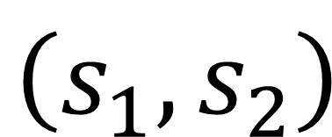

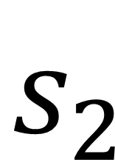
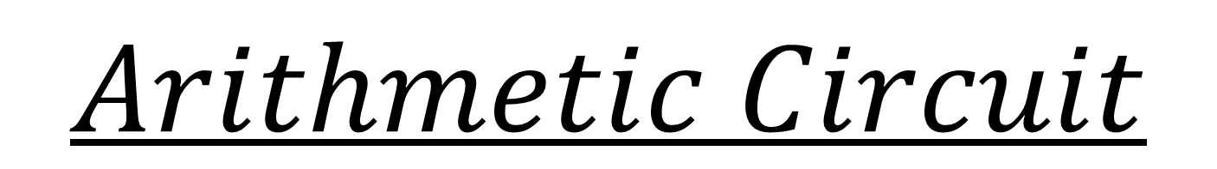


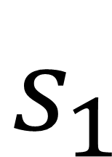



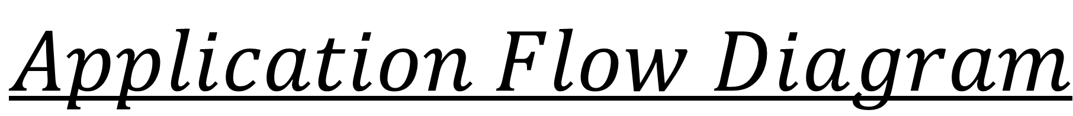
הפקולטה למדעי ההנדסה
המחלקה להנדסת מערכות תקשורת
371-20-10
Fully Secure Three-Party Computation
Vitali Lopushenko Osher saragani
Supervisor: Dr Niv Gilboa
Our contribution is implementing the protocol that introduced in The paper “Practical Fully Secure Three-Party Computation via Sublinear Distributed Zero-Knowledge Proofs” by Niv Gilboa et el (CCS' 19 Nov 11-15).
$$Project Goal$$
$$Overview$$
MPC – Multi Party computation, in our case its 3PC.
Honest Majority – We assume that most of the parties is honest (2 out of 3 are honest).
Semi-Honest – Malicious party that trying to learn as much as possible but continue to follow the protocol.
Secret Sharing – Is a functionality that share some secret among few Parties, without reveal the secret itself.
Coding in C++ Windows Environment, Visual Studio IDE, Git for source control, threads for optimization, Crypto++ Lib for secure random numbers and Cryptographic functions.
$$Work Environment$$
$$Application Flow Diagram$$
The protocol is fully secure. In each step at the program, we can detect the malicious party and abort.
When starting the protocol, the C circuit and few more parameters known to all parties.
$$Secret Sharing$$
$$s_{1}$$
$$p_{1}$$
$$s$$
$$\left(s_{1},s_{2}\right)$$
$$s_{2}$$
$$p_{2}$$
$$\left(s_{2},s_{3}\right)$$
$$s_{3}$$
$$p_{3}$$
$$\left(s_{3},s_{1}\right)$$
$$Arithmetic Circuit$$
$$Verification$$
Most computation can be done locally except multiplication between two shares that require extra communication.
Party $p_{i}$multiplication between two shares and correlated randomness $\left[\left[u\right]\right]⋅\left[\left[v\right]\right]=z_{i}$
$$z_{i}=u_{i}⋅v_{i}+u_{i}⋅v_{i−1}+u_{\dot{l}−1}⋅ν_{i}+α_{i}$$
$α_{1}+α_{2}+α_{3}=0$
In the verification stage we want to ensure that all parties followed the protocol before reconstructing the output.
Compered to previous work, the verification stage is optimized to use minimal among of communication for better performance.
It can be done with Fully Linear Probabilistically Checkable Proofs (PCP)
Share
Share
Share
Const
Share
+
Share
Share
+
Const
C

